Slide 1


FoodEase Online Tiffin Management System Guided by – Mrs. Gauri Kadam Mam Bhavesh Chaudhari – 233147 Shashikant Badgujar - 233085

Slide 2
Introduction:-
FoodEase is a cutting-edge online tiffin service that aims to revolutionize the way people order and enjoy meals. The platform provides customers with access to a diverse menu of home-cooked meals prepared by local homemakers who run mess services. The focus of FoodEase is to make the process of ordering food as convenient and efficient as possible, while also delivering high-quality and authentic meals.
FoodEase is committed to providing an enjoyable and memorable food experience for its customers. Whether it's for a quick lunch break or a family dinner, FoodEase offers a range of meal options that are sure to please everyone's taste buds.

Slide 3
Objective :-
We have designed this website with the purpose of allowing customers to order home-style meals from local homemakers. This site is an attempt to provide a convenient and efficient solution for customers to access quality meals, and for homemakers to reach a wider audience and manage their business efficiently.

Slide 4
Technology Used:-
Technology : J2SE and J2EE, Hibernate and Spring Boot
Web-Technologies : React, CSS, JavaScript
Web Server : Tomcat 9.0
Java Version : JAVA Version 11
Backend Database : MySQL 8.0
IDE : Spring Tool Suite(STS)

Slide 5
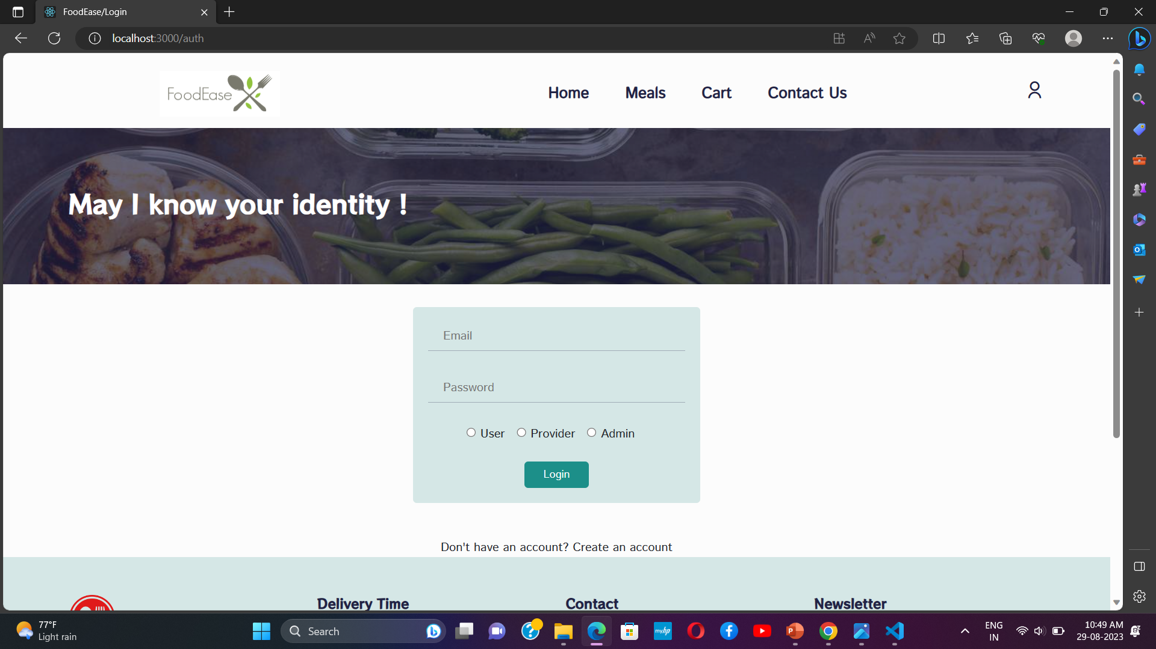
UI of FoodEase
Login Page

Slide 6

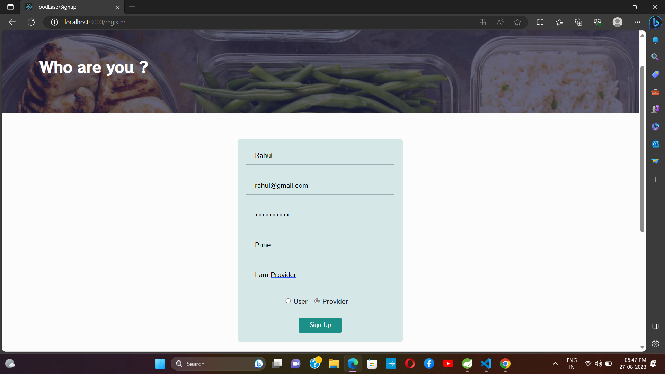
UI of FoodEase
Provider Register Page

Slide 7
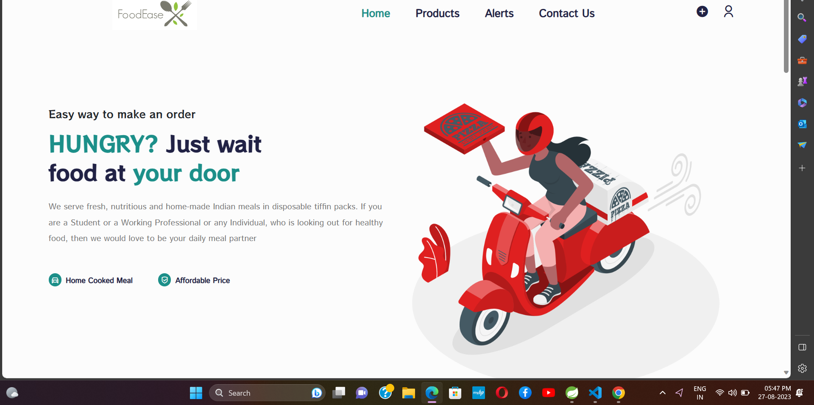
After Provider Login
UI of FoodEase

Slide 8
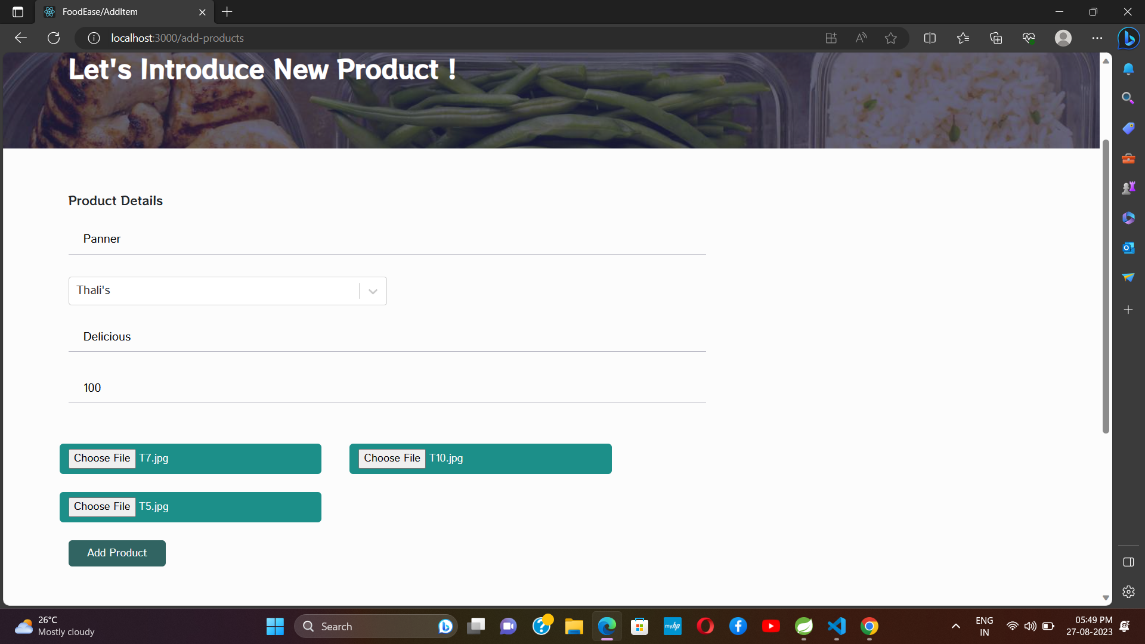
UI of FoodEase
Meals Add

Slide 9
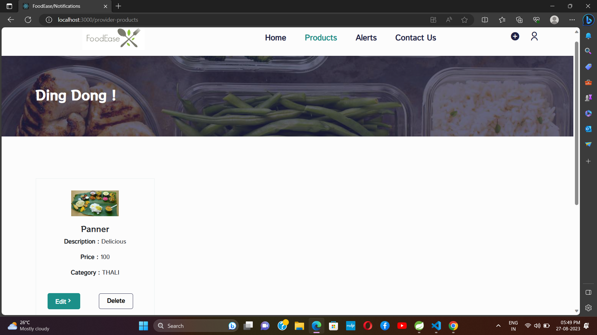
UI of FoodEase
After Meals Add

Slide 10
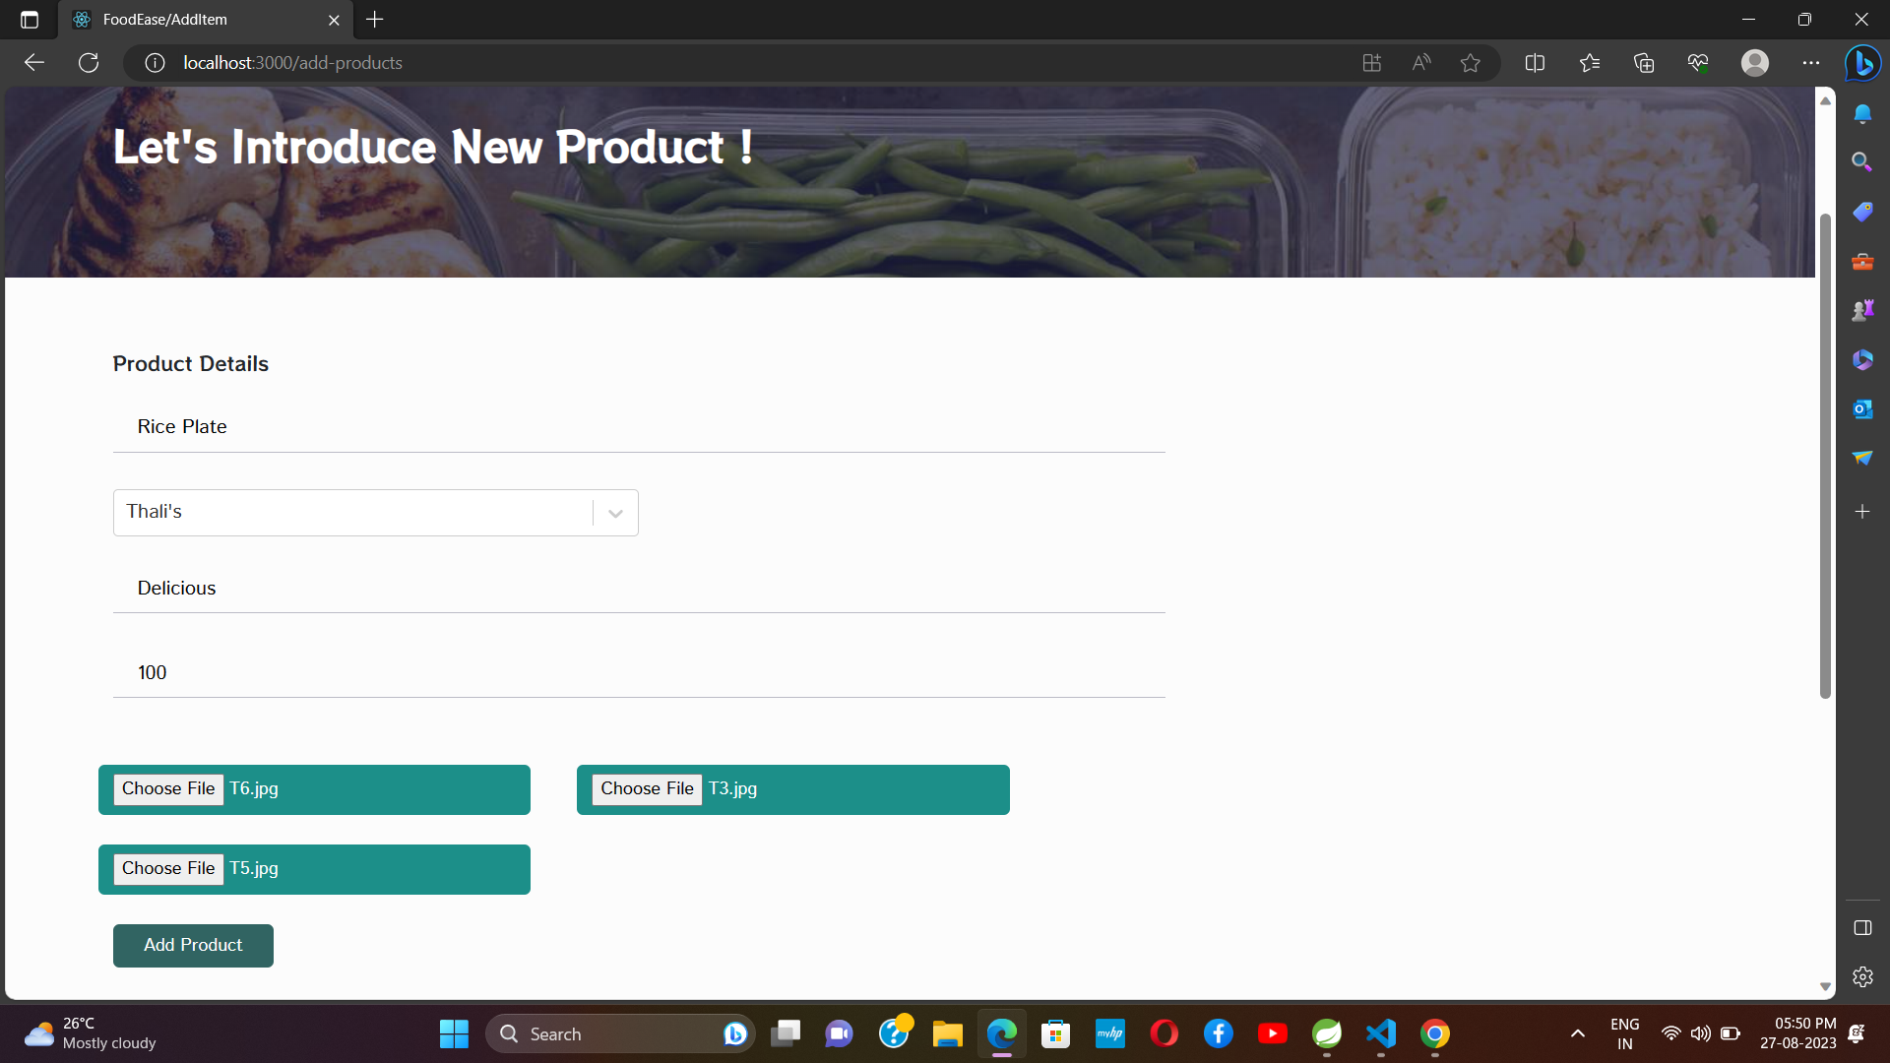
UI of FoodEase
After Click Edit button

Slide 11
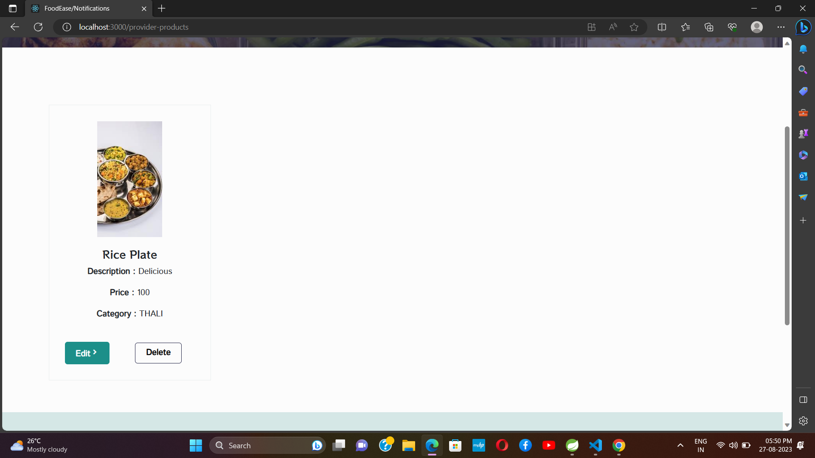
UI of FoodEase
After Edit Meals

Slide 12
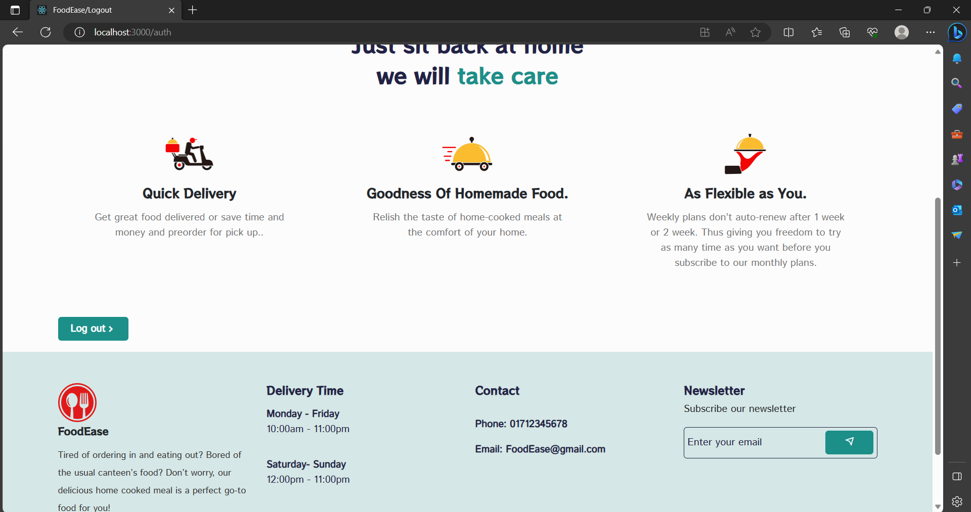
UI of FoodEase
Provider Logout

Slide 13
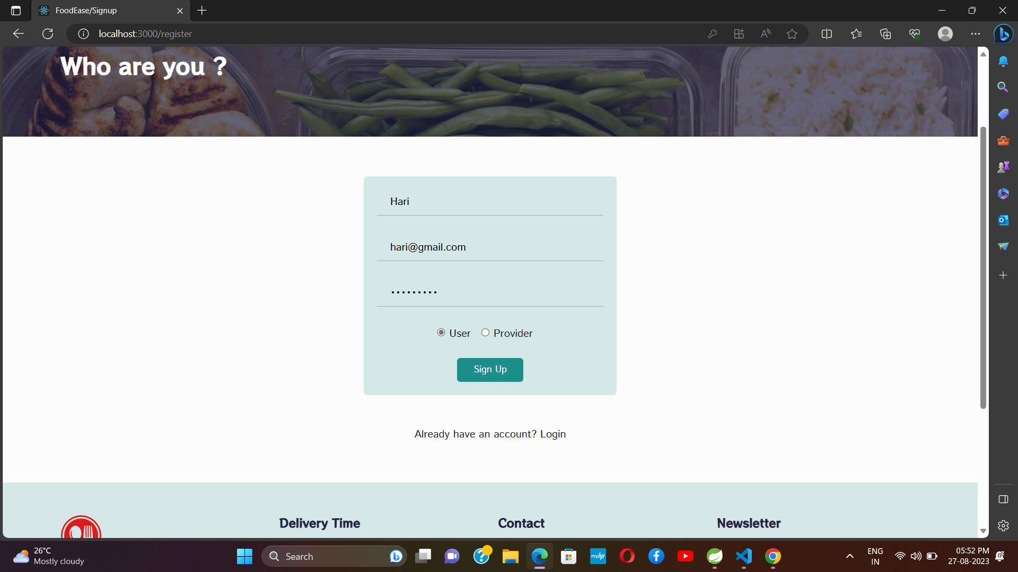
UI of FoodEase
User Registration Page

Slide 14
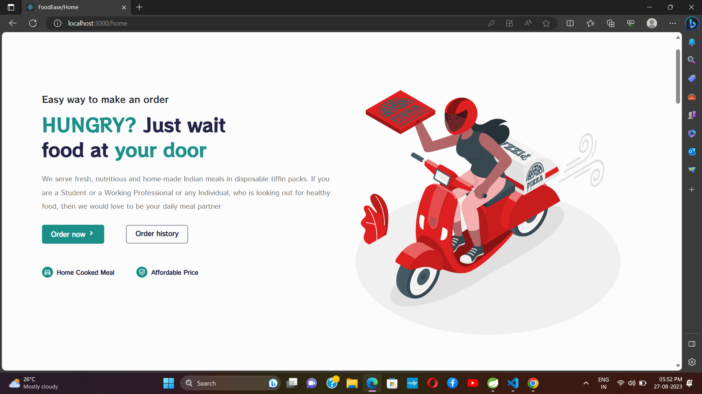
UI of FoodEase
After Login User

Slide 15
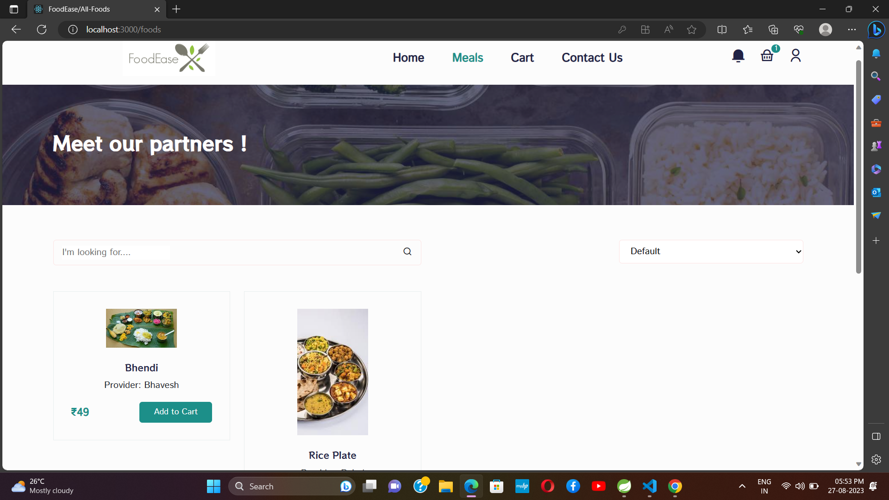
UI of FoodEase
After Click on Meals

Slide 16
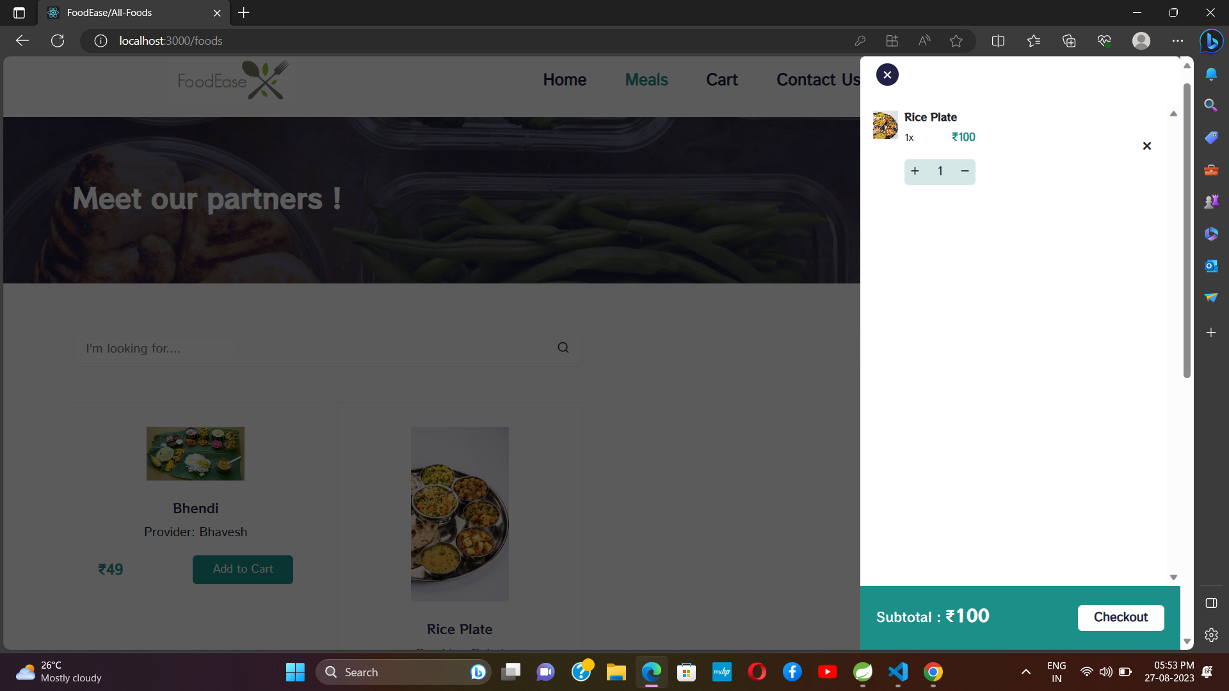
UI of FoodEase
After Click on Add Cart

Slide 17
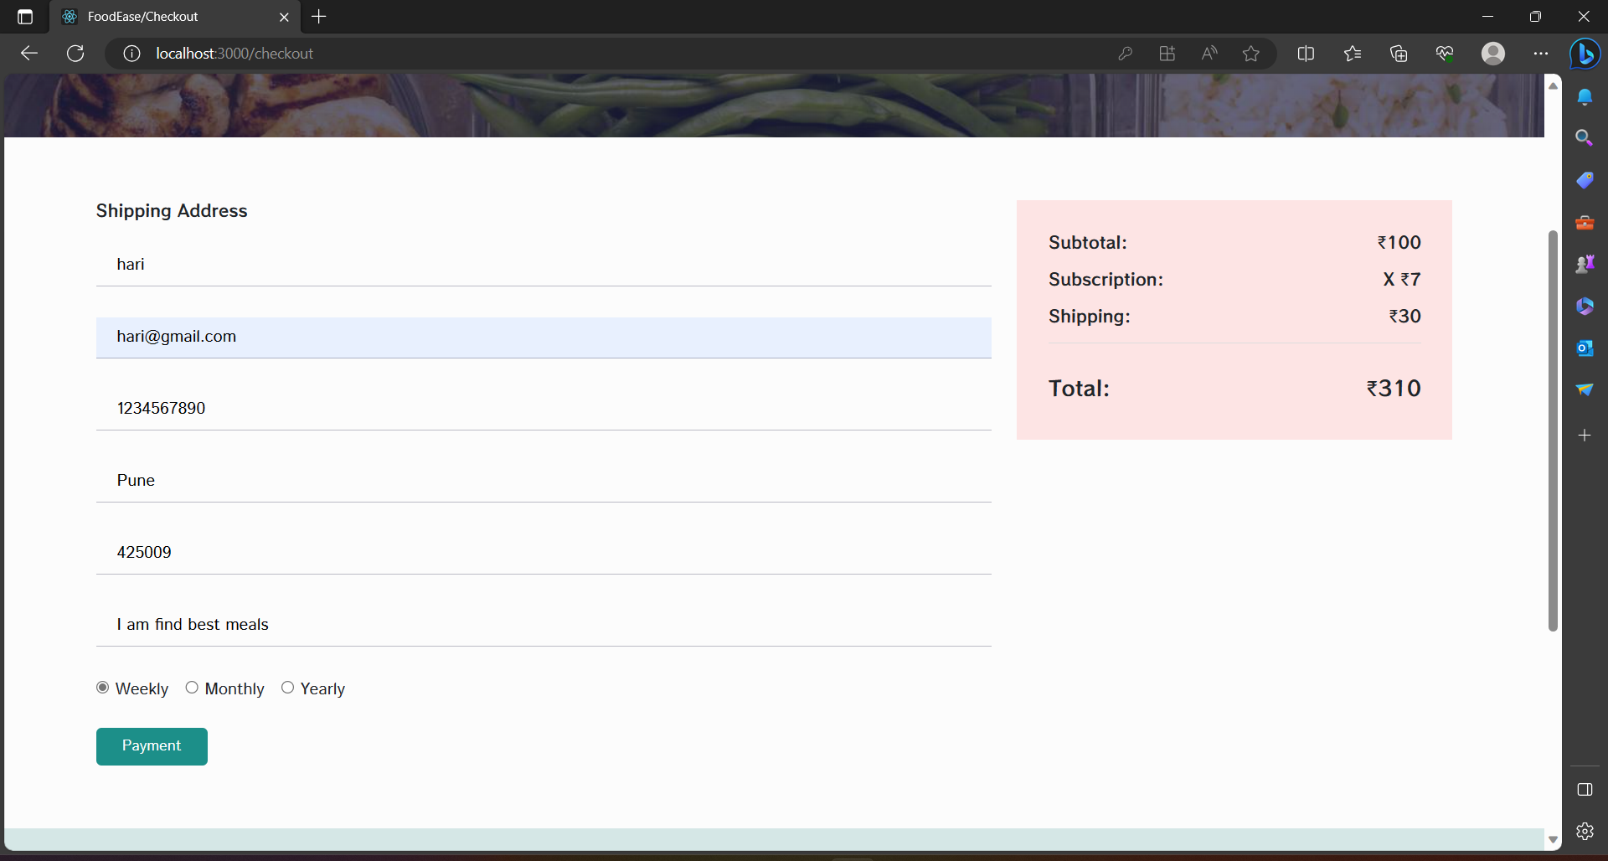
UI of FoodEase
Payment

Slide 18
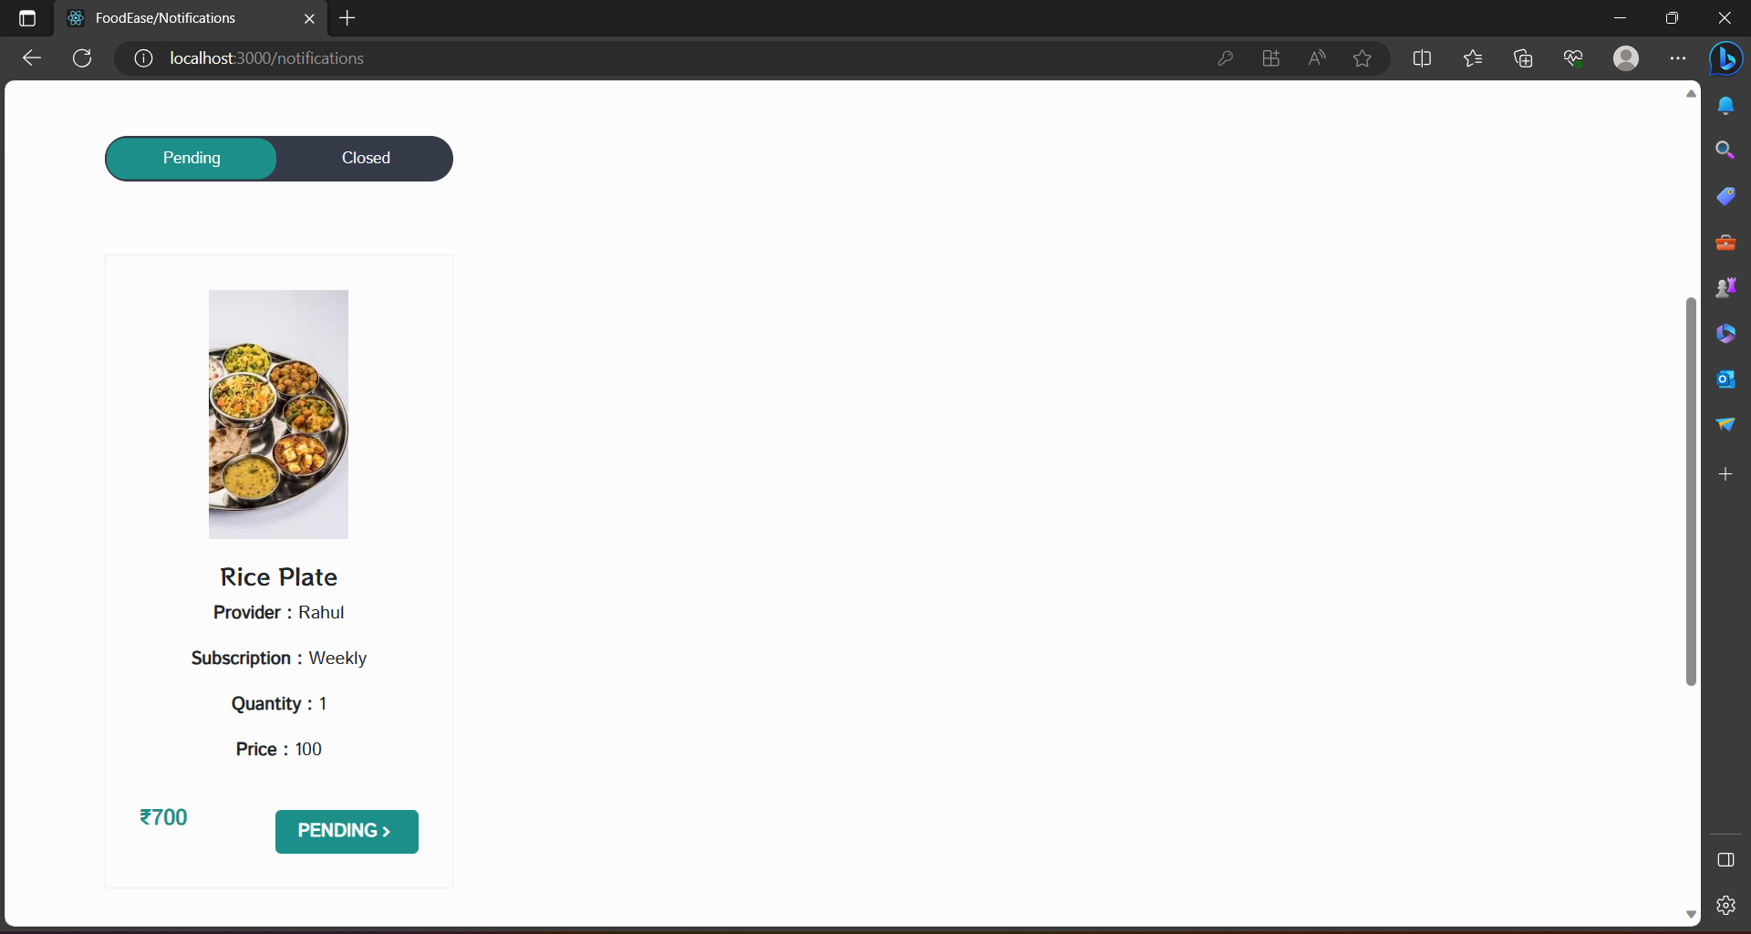
UI of FoodEase
User Status after payment

Slide 19
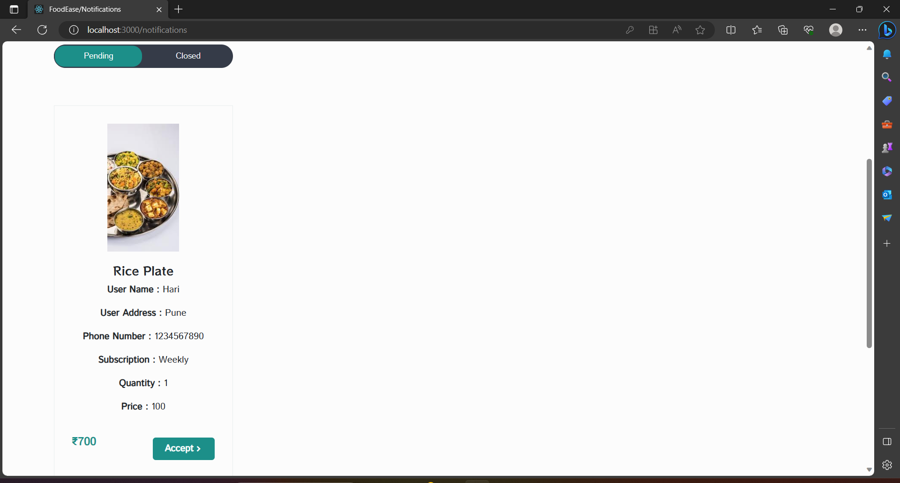
UI of FoodEase
Provider Accept Order

Slide 20
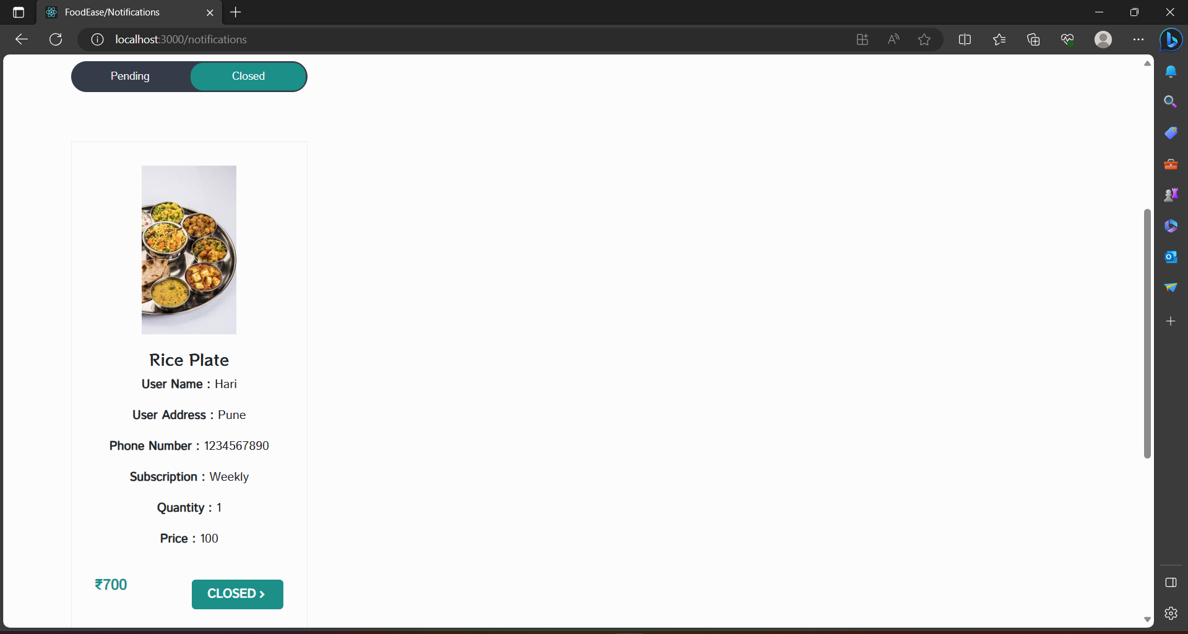
UI of FoodEase
After Provider accept order User Order status closed

Slide 21
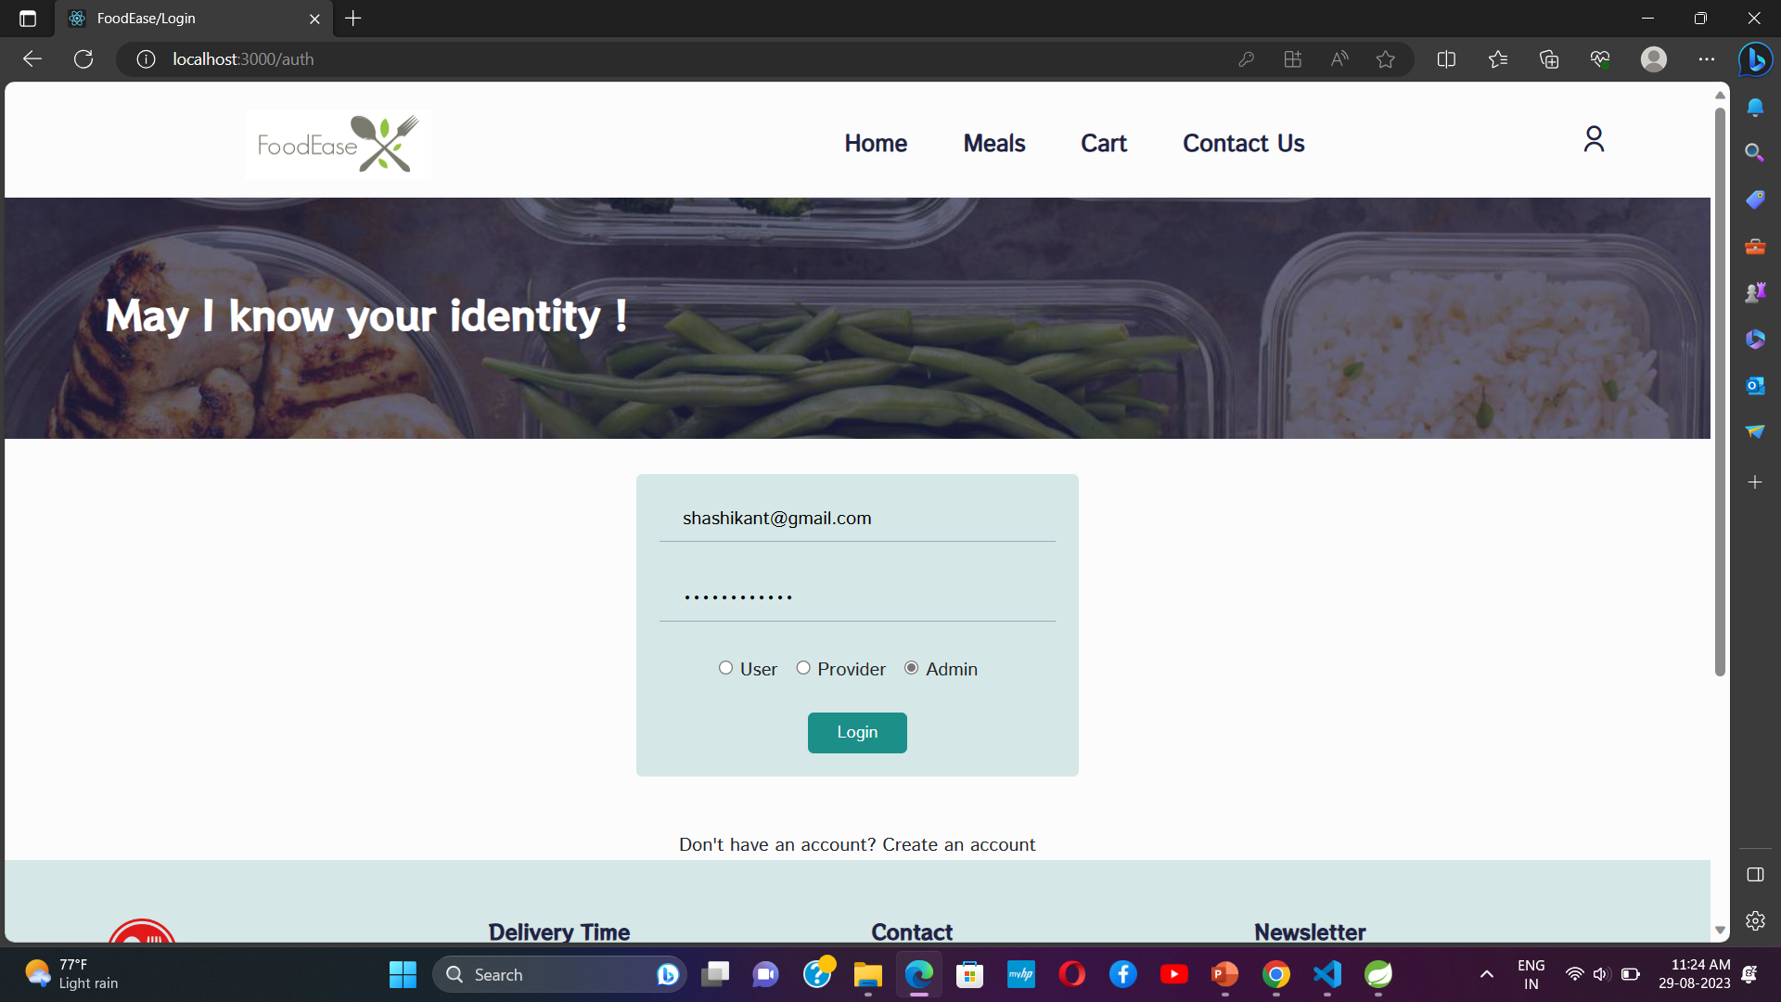
UI of FoodEase
Admin Login Page

Slide 22
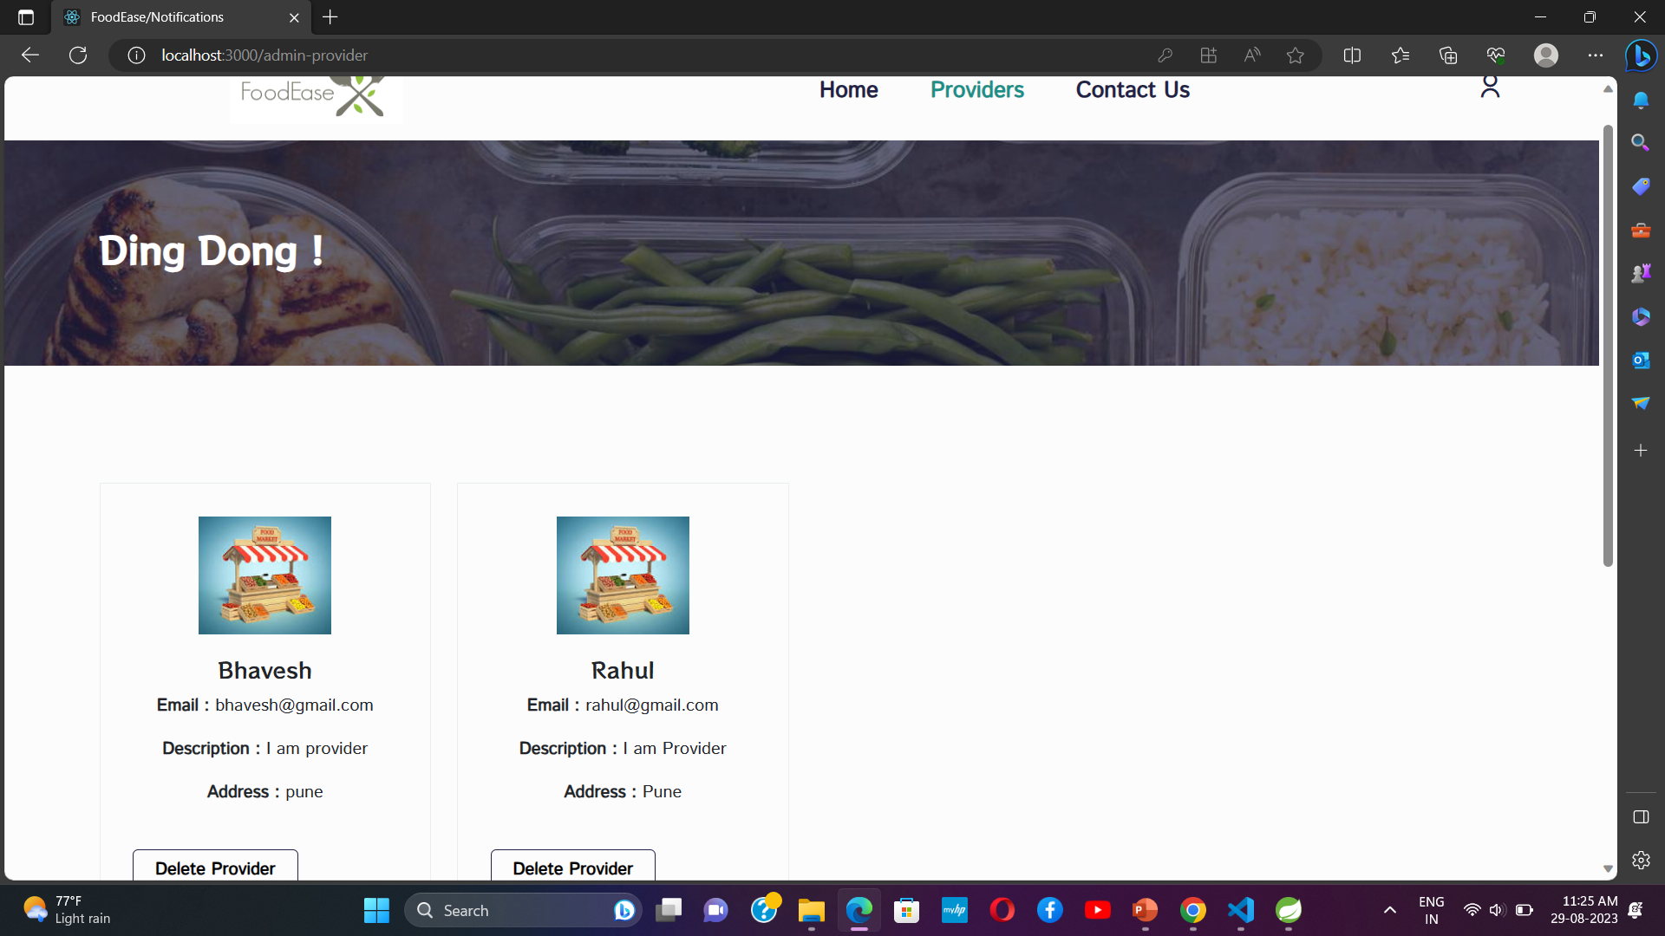
UI of FoodEase
Admin Can Delete Provider Completely

Slide 23
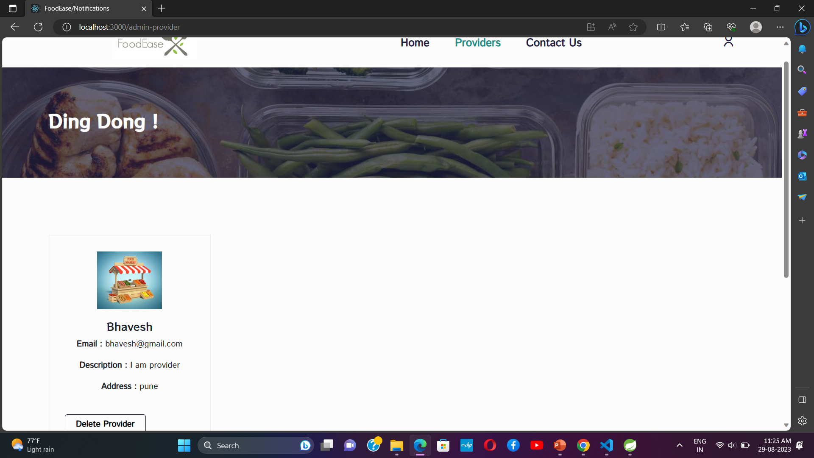
UI of FoodEase
After Delete Provider

Slide 24
UI of FoodEase
Admin Logout

Slide 25
Conclusion:-
In conclusion, FoodEase is a platform that aims to revolutionize the home mess system by providing a convenient and efficient solution for ordering food. It brings together customers, home chefs and delivery partners on a single platform to make food ordering seamless and hassle-free. With its user-friendly interface, advanced security features and integrated payment system, FoodEase offers a complete solution for all food-related needs. However, there is always room for improvement, and the platform is open to future updates and enhancements to better serve the needs of its users.

Slide 26
Future Scope:-
Incorporate machine learning algorithms for personalized menu recommendations.
Provide in-app payment options.
Have a feature for customer feedback and reviews.
Add a loyalty program for repeat customers.
Integrating with smart home devices for better order management

Slide 27
References:-
Java Complete Reference by Herbert S.
Database Programming with JDBC and Java by George Reese.
https://Draw.io/
Wikipedia, URL: http://www.wikipedia.org.
https://reactrouter.com/
Google, URL: http://www.google.co.in
https://start.spring.io/
https://Javatpoint.com/
https://www.geeksforgeeks.org/
https://mysqltutorial.org

Slide 28
Thank You

